Slide 1
William Stallings
Data and Computer Communications
7th Edition
Chapter 16
High Speed LANs

Slide 2
Introduction
Range of technologies
  Fast and Gigabit Ethernet
  Fibre Channel
  High Speed Wireless LANs

Slide 3
Why High Speed LANs?
Office LANs used to provide basic connectivity
  Connecting PCs and terminals to mainframes and midrange systems that ran corporate applications
  Providing workgroup connectivity at departmental level
  Traffic patterns light
    Emphasis on file transfer and electronic mail
Speed and power of PCs has risen
  Graphics-intensive applications and GUIs
MIS organizations recognize LANs as essential
  Began with client/server computing
    Now dominant architecture in business environment
    Intranetworks
    Frequent transfer of large volumes of data

Slide 4
Applications Requiring High Speed LANs
Centralized server farms
  User needs to draw huge amounts of data from multiple centralized servers
  E.g. Color publishing
    Servers contain tens of gigabytes of image data
    Downloaded to imaging workstations
Power workgroups
Small number of cooperating users
  Draw massive data files across network
  E.g. Software development group testing new software version or computer-aided design (CAD) running simulations
High-speed local backbone
  Processing demand grows
  LANs proliferate at site
  High-speed interconnection is necessary

Slide 5
Ethernet (CSMA/CD)
Carriers Sense Multiple Access with Collision Detection
Xerox - Ethernet
IEEE 802.3

Slide 6
IEEE802.3 Medium Access Control
Random Access
  Stations access medium randomly
Contention
  Stations content for time on medium

Slide 7
ALOHA
Packet Radio
When station has frame, it sends
Station listens (for max round trip time)plus small increment
If ACK, fine. If not, retransmit
If no ACK after repeated transmissions, give up
Frame check sequence (as in HDLC)
If frame OK and address matches receiver, send ACK
Frame may be damaged by noise or by another station transmitting at the same time (collision)
Any overlap of frames causes collision
Max utilization 18%

Slide 8
Slotted ALOHA
Time in uniform slots equal to frame transmission time
Need central clock (or other sync mechanism)
Transmission begins at slot boundary
Frames either miss or overlap totally
Max utilization 37%

Slide 9
CSMA
Propagation time is much less than transmission time
All stations know that a transmission has started almost immediately
First listen for clear medium (carrier sense)
If medium idle, transmit
If two stations start at the same instant, collision
Wait reasonable time (round trip plus ACK contention)
No ACK then retransmit
Max utilization depends on propagation time (medium length) and frame length
  Longer frame and shorter propagation gives better utilization

Slide 10
Nonpersistent CSMA
If medium is idle, transmit; otherwise, go to 2
If medium is busy, wait amount of time drawn from probability distribution (retransmission delay) and repeat 1
Random delays reduces probability of collisions
  Consider two stations become ready to transmit at same time
    While another transmission is in progress
  If both stations delay same time before retrying, both will attempt to transmit at same time
Capacity is wasted because medium will remain idle following end of transmission
  Even if one or more stations waiting
Nonpersistent stations deferential

Slide 11
1-persistent CSMA
To avoid idle channel time, 1-persistent protocol used
Station wishing to transmit listens and obeys following:
If medium idle, transmit; otherwise, go to step 2
If medium busy, listen until idle; then transmit immediately
1-persistent stations selfish
If two or more stations waiting, collision guaranteed
  Gets sorted out after collision

Slide 12
P-persistent CSMA
Compromise that attempts to reduce collisions
  Like nonpersistent
And reduce idle time
  Like1-persistent
Rules:
If medium idle, transmit with probability p, and delay one time unit with probability (1 – p)
  Time unit typically maximum propagation delay
If medium busy, listen until idle and repeat step 1
If transmission is delayed one time unit, repeat step 1
What is an effective value of p?

Slide 13
Value of p?
Avoid instability under heavy load
n stations waiting to send
End of transmission, expected number of stations attempting to transmit is number of stations ready times probability of transmitting
  np
If np > 1on average there will be a collision
Repeated attempts to transmit almost guaranteeing more collisions
Retries compete with new transmissions
Eventually, all stations trying to send
  Continuous collisions; zero throughput
So np < 1 for expected peaks of n
If heavy load expected, p small
However, as p made smaller, stations wait longer
At low loads, this gives very long delays

Slide 14
CSMA Picture HERE
NEEDS EDITING fig 16.1

Slide 15
CSMA/CD
With CSMA, collision occupies medium for duration of transmission
Stations listen whilst transmitting
If medium idle, transmit, otherwise, step 2
If busy, listen for idle, then transmit
If collision detected, jam then cease transmission
After jam, wait random time then start from step 1

Slide 16
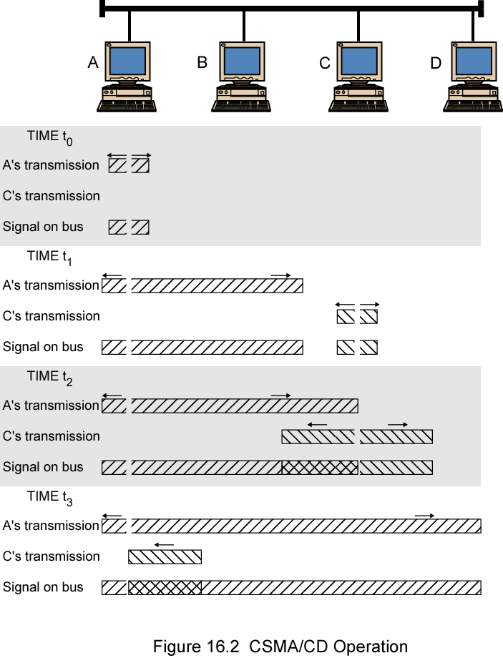
CSMA/CD
Operation

Slide 17
Which Persistence Algorithm?
IEEE 802.3 uses 1-persistent
Both nonpersistent and p-persistent have performance problems
1-persistent (p = 1) seems more unstable than p-persistent
  Greed of the stations
  But wasted time due to collisions is short (if frames long relative to propagation delay
  With random backoff, unlikely to collide on next tries
  To ensure backoff maintains stability, IEEE 802.3 and Ethernet use binary exponential backoff

Slide 18
Binary Exponential Backoff
Attempt to transmit repeatedly if repeated collisions
First 10 attempts, mean value of random delay doubled
Value then remains same for 6 further attempts
After 16 unsuccessful attempts, station gives up and reports error
As congestion increases, stations back off by larger amounts to reduce the probability of collision.
1-persistent algorithm with binary exponential backoff efficient over wide range of loads
  Low loads, 1-persistence guarantees station can seize channel once idle
  High loads, at least as stable as other techniques
Backoff algorithm gives last-in, first-out effect
Stations with few collisions transmit first

Slide 19
Collision Detection
On baseband bus, collision produces much higher signal voltage than signal
Collision detected if cable signal greater than single station signal
Signal attenuated over distance
Limit distance to 500m (10Base5) or 200m (10Base2)
For twisted pair (star-topology) activity on more than one port is collision
Special collision presence signal

Slide 20
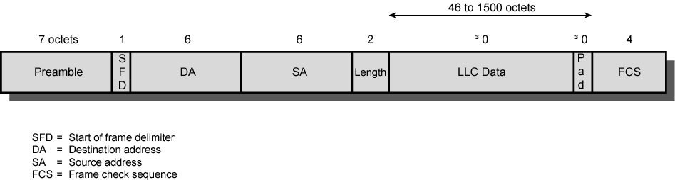
IEEE 802.3 Frame Format

Slide 21
10Mbps Specification (Ethernet)
<data rate><Signaling method><Max segment length>
10Base5 10Base2 10Base-T 10Base-F
Medium Coaxial Coaxial UTP 850nm fiber
Signaling Baseband Baseband Baseband Manchester
Manchester Manchester Manchester On/Off
Topology Bus Bus Star Star
Nodes 100 30 - 33

Slide 22
100Mbps Fast Ethernet
Use IEEE 802.3 MAC protocol and frame format
100BASE-X use physical medium specifications from FDDI
  Two physical links between nodes
    Transmission and reception
  100BASE-TX uses STP or Cat. 5 UTP
    May require new cable
  100BASE-FX uses optical fiber
  100BASE-T4 can use Cat. 3, voice-grade UTP
    Uses four twisted-pair lines between nodes
    Data transmission uses three pairs in one direction at a time
Star-wire topology
  Similar to 10BASE-T

Slide 23
100Mbps (Fast Ethernet)
100Base-TX 100Base-FX 100Base-T4
2 pair, STP 2 pair, Cat 5 UTP 2 optical fiber 4 pair, cat 3,4,5
MLT-3 MLT-3 4B5B,NRZI 8B6T,NRZ

Slide 24
100BASE-X Data Rate and Encoding
Unidirectional data rate 100 Mbps over single link
  Single twisted pair, single optical fiber
Encoding scheme same as FDDI
  4B/5B-NRZI
  Modified for each option

Slide 25
100BASE-X Media
Two physical medium specifications
100BASE-TX
  Two pairs of twisted-pair cable
  One pair for transmission and one for reception
  STP and Category 5 UTP allowed
  The MTL-3 signaling scheme is used
100BASE-FX
  Two optical fiber cables
  One for transmission and one for reception
  Intensity modulation used to convert 4B/5B-NRZI code group stream into optical signals
  1 represented by pulse of light
  0 by either absence of pulse or very low intensity pulse

Slide 26
100BASE-T4
100-Mbps over lower-quality Cat 3 UTP
  Taking advantage of large installed base
  Cat 5 optional
  Does not transmit continuous signal between packets
  Useful in battery-powered applications
Can not get 100 Mbps on single twisted pair
  Data stream split into three separate streams
    Each with an effective data rate of 33.33 Mbps
  Four twisted pairs used
  Data transmitted and received using three pairs
  Two pairs configured for bidirectional transmission
NRZ encoding not used
  Would require signaling rate of 33 Mbps on each pair
  Does not provide synchronization
  Ternary signaling scheme (8B6T)

Slide 27
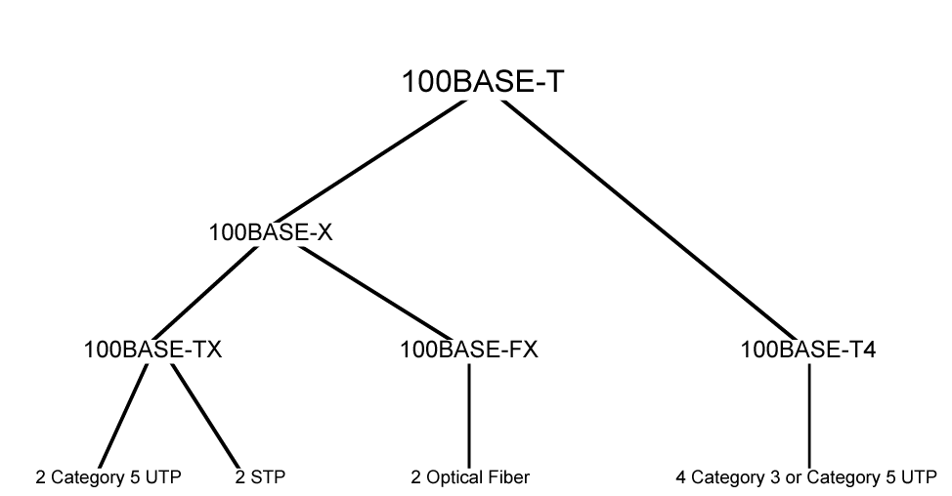
100BASE-T Options

Slide 28
Full Duplex Operation
Traditional Ethernet half duplex
  Either transmit or receive but not both simultaneously
With full-duplex, station can transmit and receive simultaneously
100-Mbps Ethernet in full-duplex mode, theoretical transfer rate 200 Mbps
Attached stations must have full-duplex adapter cards
Must use switching hub
  Each station constitutes separate collision domain
  In fact, no collisions
  CSMA/CD algorithm no longer needed
  802.3 MAC frame format used
  Attached stations can continue CSMA/CD

Slide 29
Mixed Configurations
Fast Ethernet supports mixture of existing 10-Mbps LANs and newer 100-Mbps LANs
E.g. 100-Mbps backbone LAN to support 10-Mbps hubs
  Stations attach to 10-Mbps hubs using 10BASE-T
  Hubs connected to switching hubs using 100BASE-T
    Support 10-Mbps and 100-Mbps
  High-capacity workstations and servers attach directly to 10/100 switches
  Switches connected to 100-Mbps hubs using 100-Mbps links
  100-Mbps hubs provide building backbone
    Connected to router providing connection to WAN

Slide 30
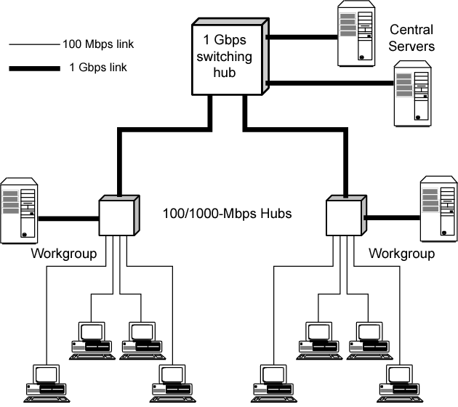
Gigabit Ethernet Configuration

Slide 31
Gigabit Ethernet - Differences
Carrier extension
At least 4096 bit-times long (512 for 10/100)
Frame bursting

Slide 32
Gigabit Ethernet – Physical
1000Base-SX
  Short wavelength, multimode fiber
1000Base-LX
  Long wavelength, Multi or single mode fiber
1000Base-CX
  Copper jumpers <25m, shielded twisted pair
1000Base-T
  4 pairs, cat 5 UTP
Signaling - 8B/10B

Slide 33
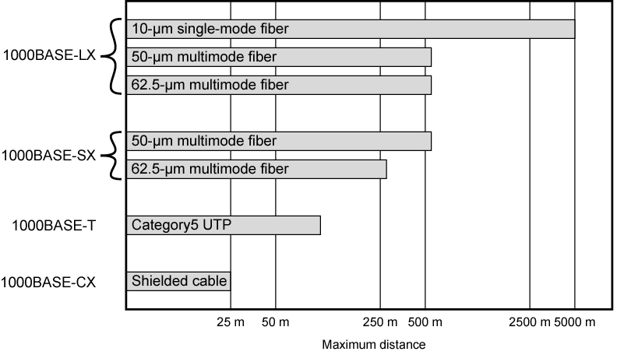
Gbit Ethernet Medium Options
(log scale)

Slide 34
10Gbps Ethernet - Uses
High-speed, local backbone interconnection between large-capacity switches
Server farm
Campus wide connectivity
Enables Internet service providers (ISPs) and network service providers (NSPs) to create very high-speed links at very low cost
Allows construction of (MANs) and WANs
  Connect geographically dispersed LANs between campuses or points of presence (PoPs)
Ethernet competes with ATM and other WAN technologies
10-Gbps Ethernet provides substantial value over ATM

Slide 35
10Gbps Ethernet - Advantages
No expensive, bandwidth-consuming conversion between Ethernet packets and ATM cells
Network is Ethernet, end to end
IP and Ethernet together offers QoS and traffic policing approach ATM
Advanced traffic engineering technologies available to users and providers
Variety of standard optical interfaces (wavelengths and link distances) specified for 10 Gb Ethernet
Optimizing operation and cost for LAN, MAN, or WAN

Slide 36
10Gbps Ethernet - Advantages
Maximum link distances cover 300 m to 40 km
Full-duplex mode only
10GBASE-S (short):
  850 nm on multimode fiber
  Up to 300 m
10GBASE-L (long)
  1310 nm on single-mode fiber
  Up to 10 km
10GBASE-E (extended)
  1550 nm on single-mode fiber
  Up to 40 km
10GBASE-LX4:
  1310 nm on single-mode or multimode fiber
  Up to 10 km
  Wavelength-division multiplexing (WDM) bit stream across four light waves

Slide 37
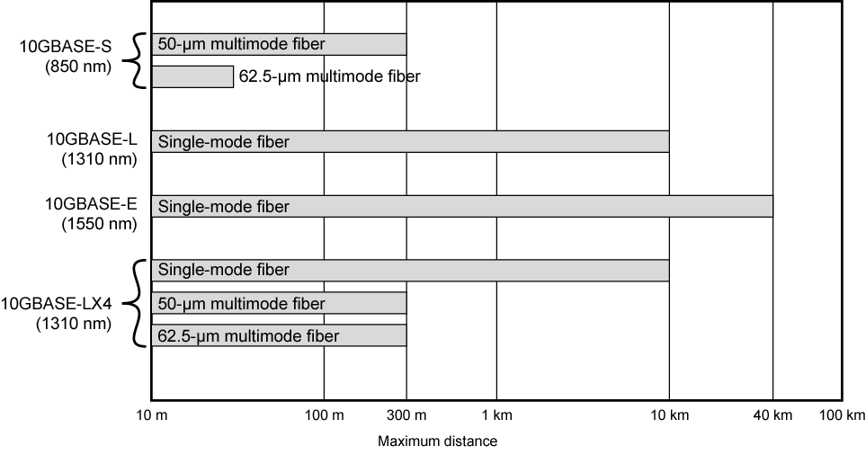
10Gbps Ethernet Distance Options (log scale)

Slide 38
Token Ring (802.5)
Developed from IBM's commercial token ring
Because of IBM's presence, token ring has gained broad acceptance
Never achieved popularity of Ethernet
Currently, large installed base of token ring products
Market share likely to decline

Slide 39
Ring Operation
Each repeater connects to two others via unidirectional transmission links
Single closed path
Data transferred bit by bit from one repeater to the next
Repeater regenerates and retransmits each bit
Repeater performs data insertion, data reception, data removal
Repeater acts as attachment point
Packet removed by transmitter after one trip round ring

Slide 40
Listen State Functions
Scan passing bit stream for patterns
  Address of attached station
  Token permission to transmit
Copy incoming bit and send to attached station
  Whilst forwarding each bit
Modify bit as it passes
  e.g. to indicate a packet has been copied (ACK)

Slide 41
Transmit State Functions
Station has data
Repeater has permission
May receive incoming bits
  If ring bit length shorter than packet
    Pass back to station for checking (ACK)
  May be more than one packet on ring
    Buffer for retransmission later

Slide 42
Bypass State
Signals propagate past repeater with no delay (other than propagation delay)
Partial solution to reliability problem (see later)
Improved performance

Slide 43
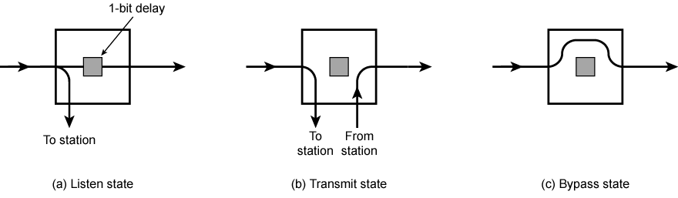
Ring Repeater States

Slide 44
802.5 MAC Protocol
Small frame (token) circulates when idle
Station waits for token
Changes one bit in token to make it SOF for data frame
Append rest of data frame
Frame makes round trip and is absorbed by transmitting station
Station then inserts new token when transmission has finished and leading edge of returning frame arrives
Under light loads, some inefficiency
Under heavy loads, round robin

Slide 45
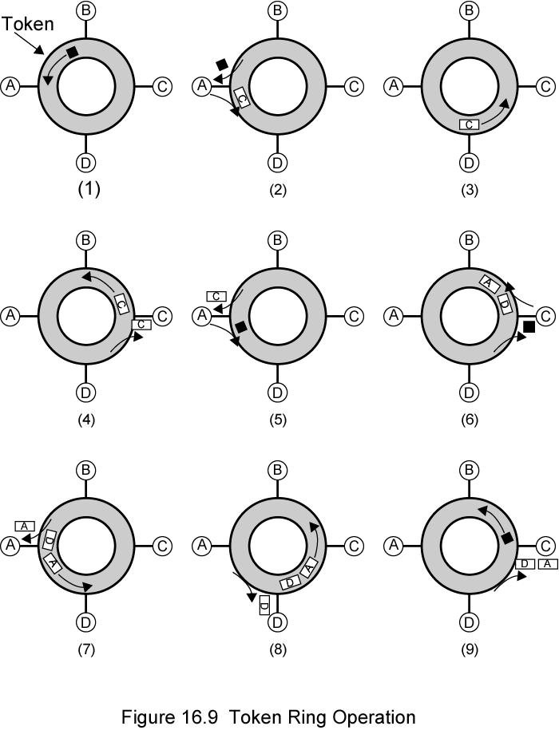
Token Ring
Operation

Slide 46
Dedicated Token Ring
Central hub
Acts as switch
Full duplex point to point link
Concentrator acts as frame level repeater
No token passing

Slide 47
802.5 Physical Layer
Data Rate 4 16 100
Medium UTP,STP,Fiber
Signaling Differential Manchester
Max Frame 4550 18200 18200
Access Control TP or DTR TP or DTR DTR
Note: 1Gbit specified in 2001
  Uses 802.3 physical layer specification

Slide 48
Fibre Channel - Background
I/O channel
  Direct point to point or multipoint comms link
  Hardware based
  High Speed
  Very short distance
  User data moved from source buffer to destiation buffer
Network connection
  Interconnected access points
  Software based protocol
  Flow control, error detection &recovery
  End systems connections

Slide 49
Fibre Channel
Best of both technologies
Channel oriented
  Data type qualifiers for routing frame payload
  Link level constructs associated with I/O ops
  Protocol interface specifications to support existing I/O architectures
    e.g. SCSI
Network oriented
  Full multiplexing between multiple destinations
  Peer to peer connectivity
  Internetworking to other connection technologies

Slide 50
Fibre Channel Requirements
Full duplex links with two fibers per link
100 Mbps to 800 Mbps on single line
  Full duplex 200 Mbps to 1600 Mbps per link
Up to 10 km
Small connectors
High-capacity utilization, distance insensitivity
Greater connectivity than existing multidrop channels
Broad availability
  i.e. standard components
Multiple cost/performance levels
  Small systems to supercomputers
Carry multiple existing interface command sets for existing channel and network protocols
Uses generic transport mechanism based on point-to-point links and a switching network
Supports simple encoding and framing scheme
In turn supports a variety of channel and network protocols

Slide 51
Fibre Channel Elements
End systems - Nodes
Switched elements - the network or fabric
Communication across point to point links

Slide 52
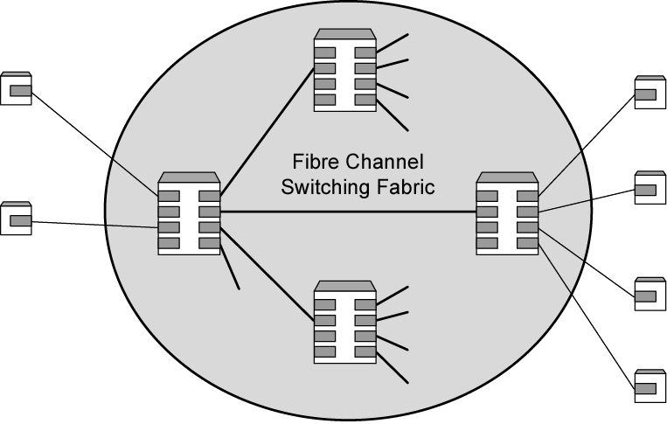
Fibre Channel Network

Slide 53
Fibre Channel Protocol Architecture (1)
FC-0 Physical Media
  Optical fiber for long distance
  coaxial cable for high speed short distance
  STP for lower speed short distance
FC-1 Transmission Protocol
  8B/10B signal encoding
FC-2 Framing Protocol
  Topologies
  Framing formats
  Flow and error control
  Sequences and exchanges (logical grouping of frames)

Slide 54
Fibre Channel Protocol Architecture (2)
FC-3 Common Services
  Including multicasting
FC-4 Mapping
  Mapping of channel and network services onto fibre channel
    e.g. IEEE 802, ATM, IP, SCSI

Slide 55
Fibre Channel Physical Media
Provides range of options for physical medium, the data rate on medium, and topology of network
Shielded twisted pair, video coaxial cable, and optical fiber
Data rates 100 Mbps to 3.2 Gbps
Point-to-point from 33 m to 10 km

Slide 56
Fibre Channel Fabric
General topology called fabric or switched topology
Arbitrary topology includes at least one switch to interconnect number of end systems
May also consist of switched network
  Some of these switches supporting end nodes
Routing transparent to nodes
  Each port has unique address
  When data transmitted into fabric, edge switch to which node attached uses destination port address to determine location
  Either deliver frame to node attached to same switch or transfers frame to adjacent switch to begin routing to remote destination

Slide 57
Fabric Advantages
Scalability of capacity
  As additional ports added, aggregate capacity of network increases
  Minimizes congestion and contention
  Increases throughput
Protocol independent
Distance insensitive
Switch and transmission link technologies may change without affecting overall configuration
Burden on nodes minimized
  Fibre Channel node responsible for managing point-to-point connection between itself and fabric
  Fabric responsible for routing and error detection

Slide 58
Alternative Topologies
Point-to-point topology
  Only two ports
  Directly connected, with no intervening switches
  No routing
Arbitrated loop topology
  Simple, low-cost topology
  Up to 126 nodes in loop
  Operates roughly equivalent to token ring
Topologies, transmission media, and data rates may be combined

Slide 59
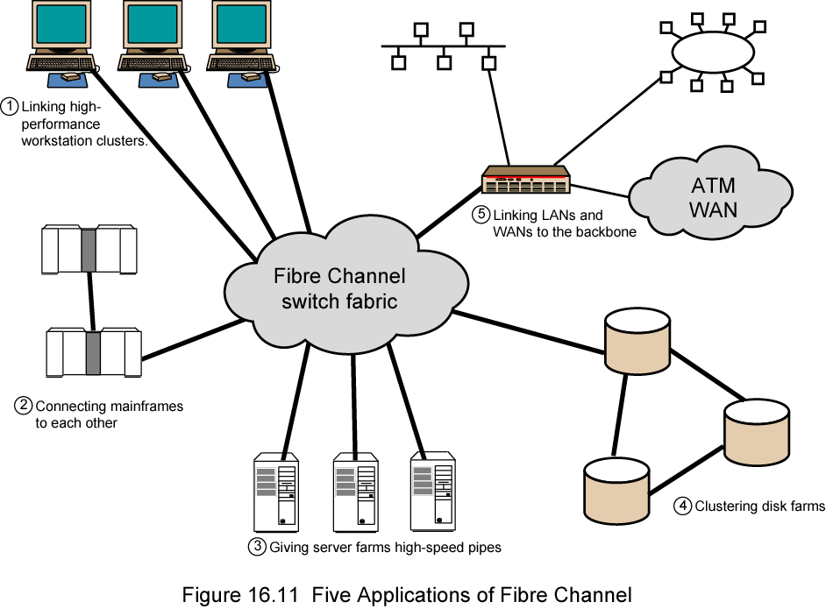
Five Applications of Fibre Channel

Slide 60
Fibre Channel Prospects
Backed by Fibre Channel Association
Interface cards for different applications available
Most widely accepted as peripheral device interconnect
  To replace such schemes as SCSI
Technically attractive to general high-speed LAN requirements
Must compete with Ethernet and ATM LANs
Cost and performance issues should dominate the consideration of these competing technologies

Slide 61
Required Reading
Stallings chapter 16
Web sites on Ethernet, Gbit Ethernet, 10Gbit Ethernet, Token ring, Fibre Channel etc.

